Slide 1
Oregon State University NASA USLI CDR
01/12/2018
1

Slide 2
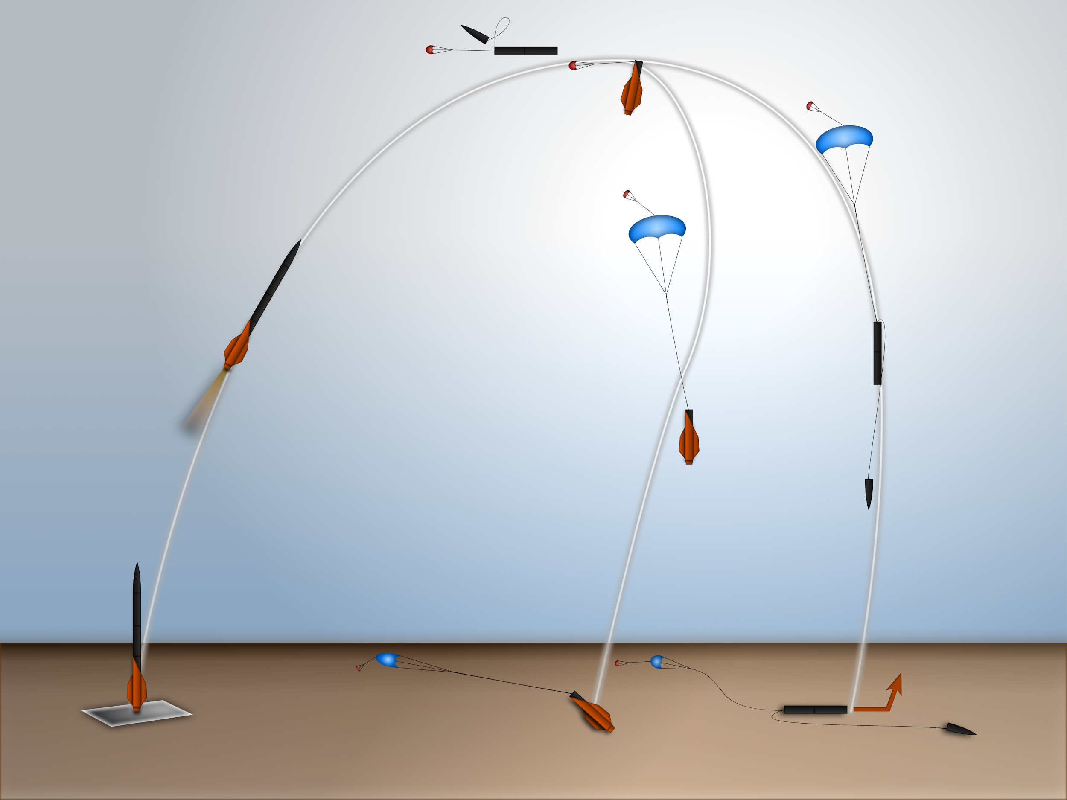
Mission Overview
Projected altitude of 5199 ft.
2 section separation at apogee
Main deployment at 800 ft.
Autonomous rover ejection
Solar panel deployment
2

Slide 3
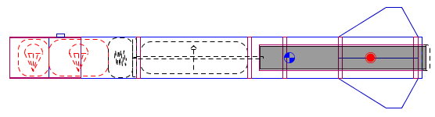
Motor Section
Section: 47 in.
Motor
Lower avionics telemetry unit (ATU)
Lower recovery controller (ReCo)
Lower recovery harness
3

Slide 4
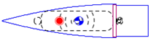
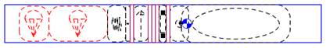
Payload Section
Nose Cone: 17.5 in.
Aluminum tip
Upper ATU
Recovered with payload section
Payload Section: 43 in.
Payload
Payload ejection controller (PLEC)
Upper ReCo
Upper recovery harness
4

Slide 5
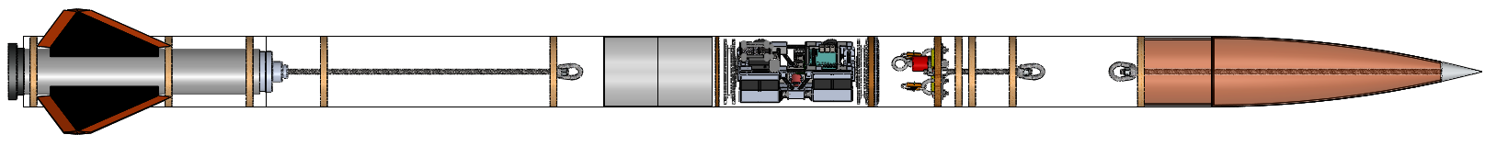
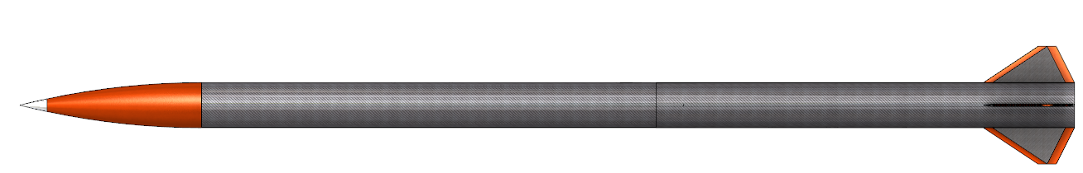
Structural Overview
Weight at Launch: 37.5 lb.
Inner Diameter: 5.2 in.
Length: 118 in.
5

Slide 6
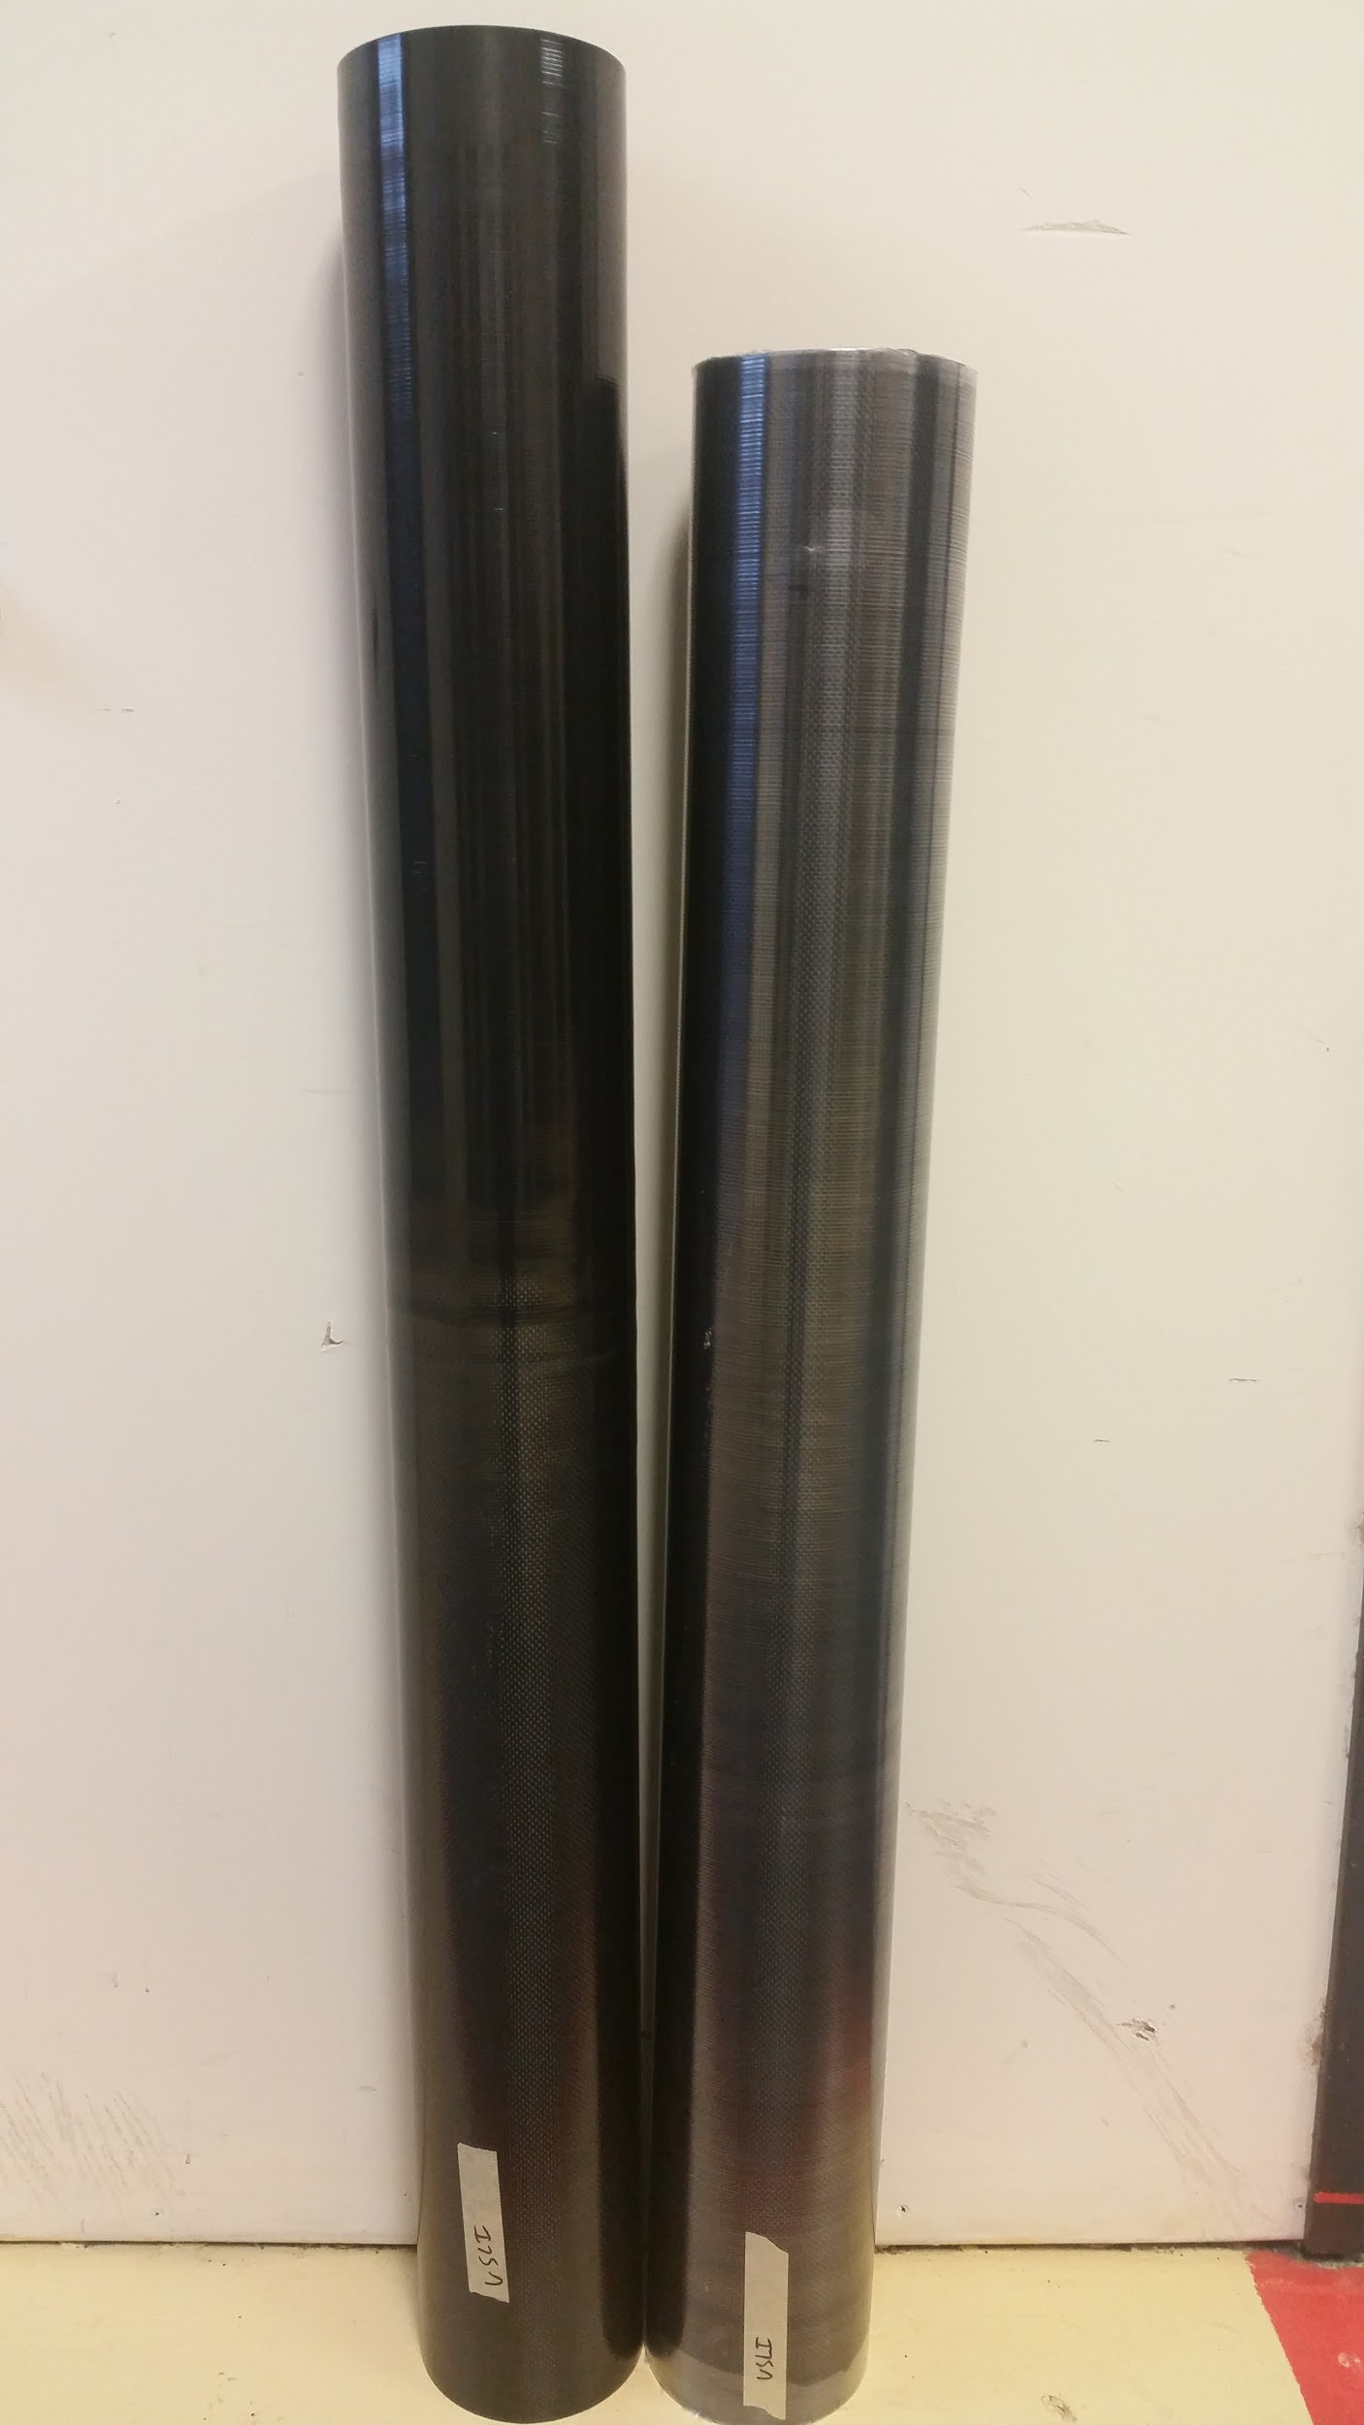
Airframe
Upper Section
Material: Carbon fiber
Length: 43 in.
Inner Diameter: 5.2 in.
Lower Section
Material: Carbon fiber/fiberglass
Length: 47 in.
Inner Diameter: 5.2 in.
6

Slide 7
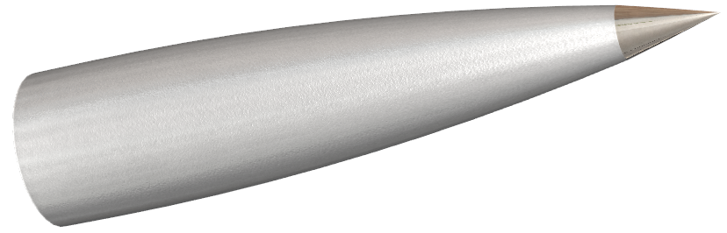
Nose Cone
Design: 4:1 Ogive nose cone
Nose Cone Material: Fiberglass
Tip Material: Aluminum as anchoring point
7

Slide 8
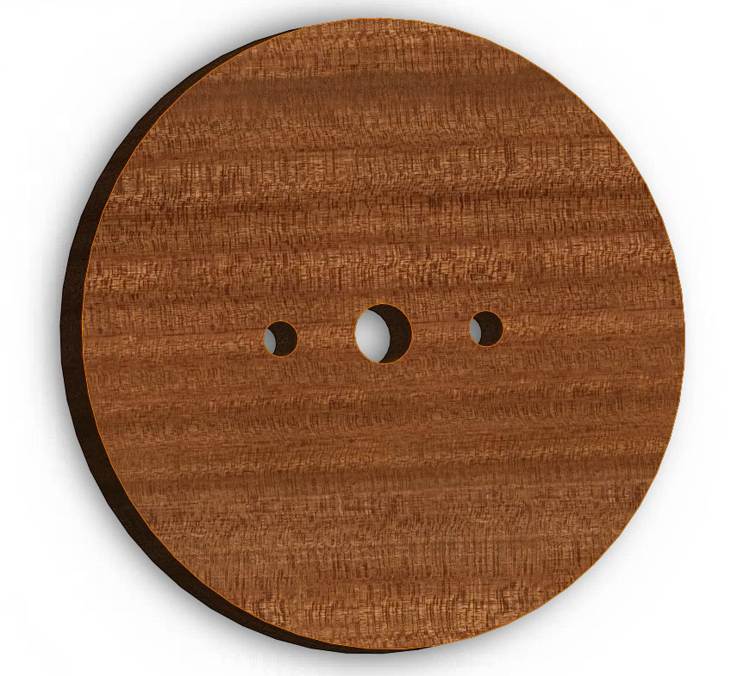
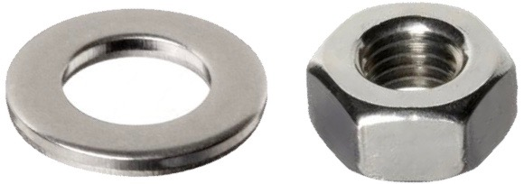
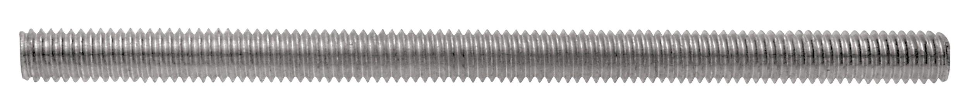
Mounting Overview
Seven ½ in. thick plywood bulkheads (9-ply)
Three threaded rods
8

Slide 9
Bulkheads
Three bulkheads epoxied to body
Structural mounting
Sealed to body
Four bulkheads for mounting
Cap sections
Provide pressure seal
Through holes for wiring
Removable for internal access
9

Slide 10
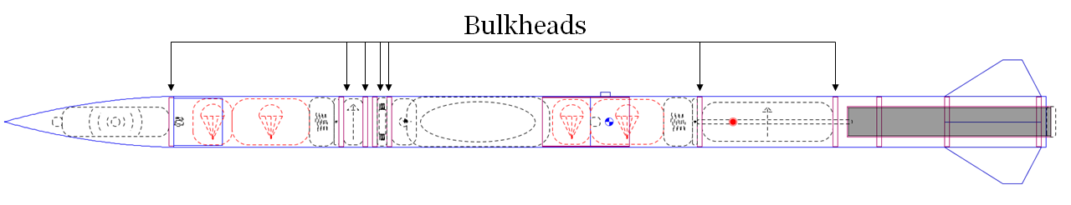
Bulkheads: Locations
Nose Cone: 1 bulkhead
Upper Section: 4 bulkheads
Lower Section: 2 bulkheads
10

Slide 11
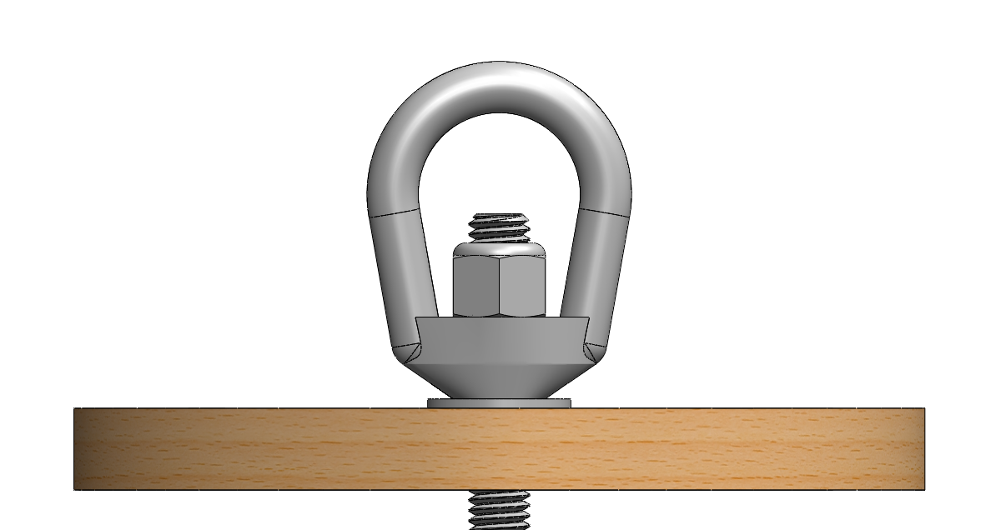
Bulkhead: Recovery Mounting
Three piece system
Nut
Eye
Washer
Standard system for all recovery mounting
11

Slide 12
Threaded Rods
3 Threaded rods
Motor to aft recovery eye-nut assembly
Payload ejection bulkhead to forward eye-nut
Nose-cone bulkhead to nose-cone tip
12

Slide 13
Threaded Rods
3 Hardpoints
Nose cone
Paired bulkhead
Forward retainer
Hardpoints to mount each rod
One hardpoint per section
13

Slide 14
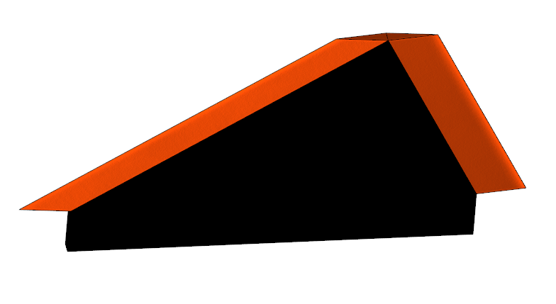
Fins
Trapezoidal fin shape
Fin thickness of 0.25 in.
Carbon fiber/Nomex honeycomb sandwich
14

Slide 15
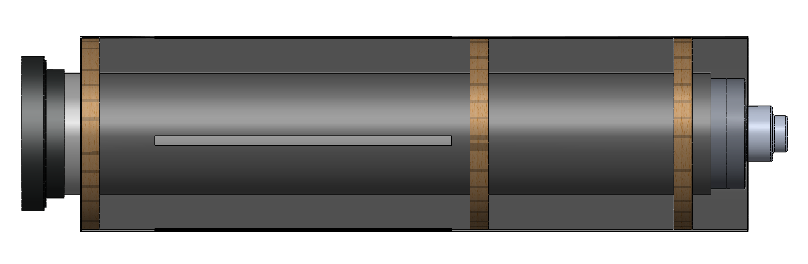
Motor Retainment
3 Centering rings
3 in. motor mount tube
Aluminum retainer
15

Slide 16
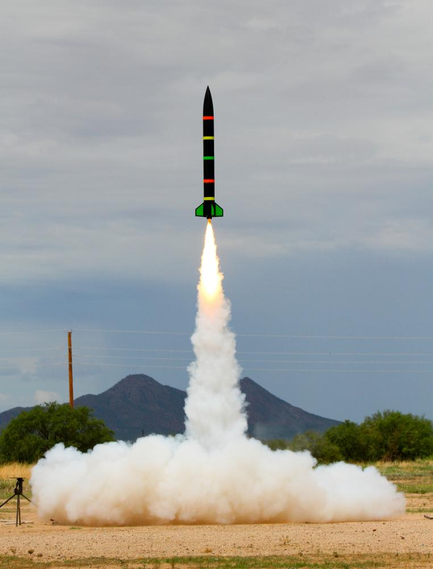
Final Motor Choice
Motor: Aerotech L850W
Total Impulse: 830.7 lbf.-s.
Mounting Diameter: 75 mm
Liftoff Thrust: 227.0 lb.
Plugged Motor
http://www.rocketryforum.com/attachment.php?attachmentid=134470&d=1371596603
16

Slide 17
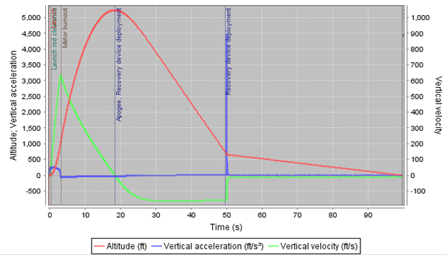
Rocket Flight Profile
17

Slide 18
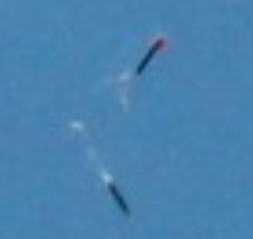
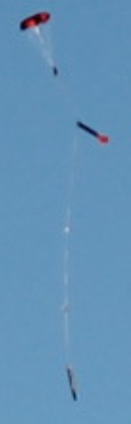
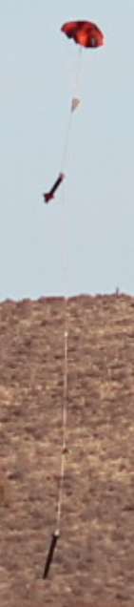
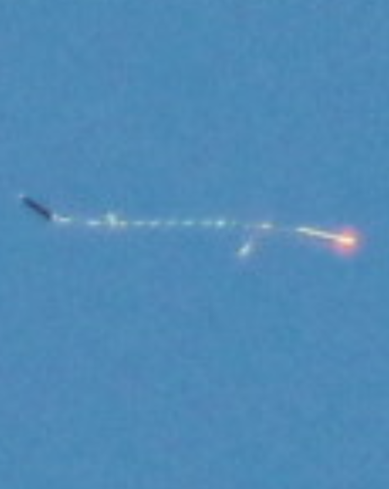
Flight Profile Continued
Apogee: 5199 ft.
Thrust to Weight Ratio: 6.05
Maximum Velocity: 576 ft./s
Rail Exit Velocity: 65 ft./s
18

Slide 19
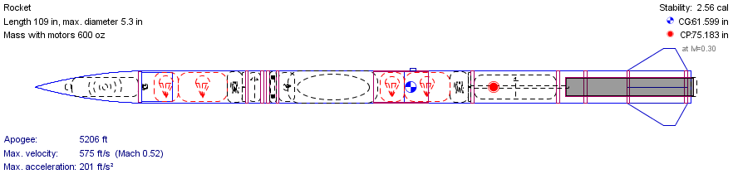
Aerodynamics/Recovery Overview
Aerodynamic System:
CG is 61.6 in., CP is 75.2 in. aft of tip
Stability: 2.56 calibers
Estimated Altitude: 5199 ft.
Ogive nose cone and clipped delta fins
19

Slide 20
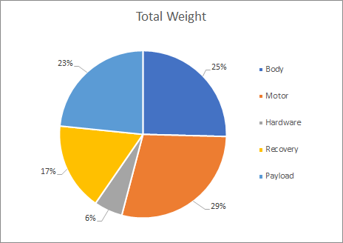
Mass Statement and Margin
Section | Weight (lb.)
Body | 9.94
Motor | 10.54
Hardware | 2.031
Recovery | 6.24
Payload | 8.6
Total | 37.50
20

Slide 21
Mass Statement and Margin
Section | Weight (lb.)
Body | 9.94
Motor | 10.54
Hardware | 2.031
Recovery | 6.24
Payload | 8.6
Total | 37.50
Section | Current Weight (lb.) | Margin | Max Weight (lb.)
Fore | 19 | 2.4 | 21.4
Aft | 18.5 | 5 | 23.5
Mass margin defined by current parachute selection
21

Slide 22
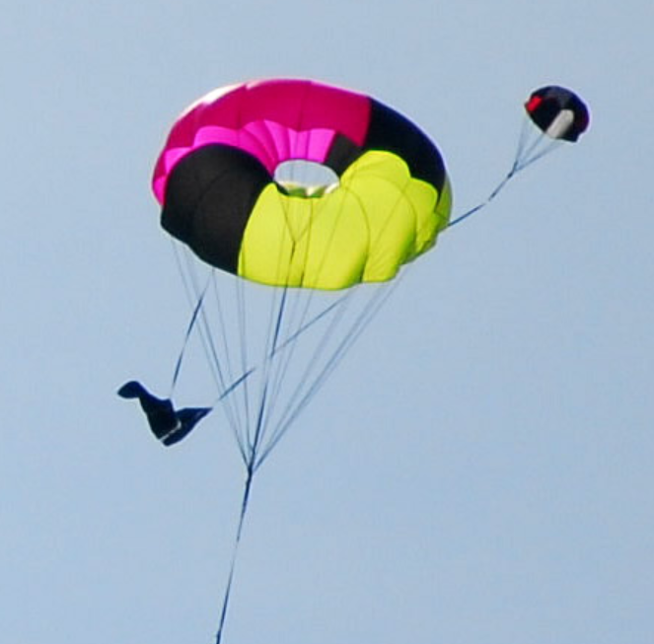
Recovery: Parachutes
Main Parachutes: Fruity Chutes Iris Standard
Drogue Chutes: Top Flight X-Type
Drogue Velocities: 76.9 - 80.4 ft./s
Main Velocities: 14.5 - 14.9 ft./s
Landing KE: 55.0 ft.-lbf., 51.1 ft.-lbf.
1 in. Tubular Nylon Harness,
Fore 23 ft., Aft 20 ft.
22

Slide 23
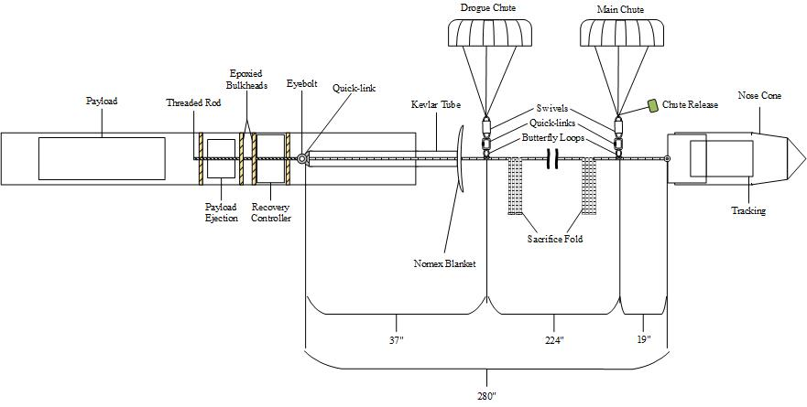
Fore Recovery Section
23

Slide 24
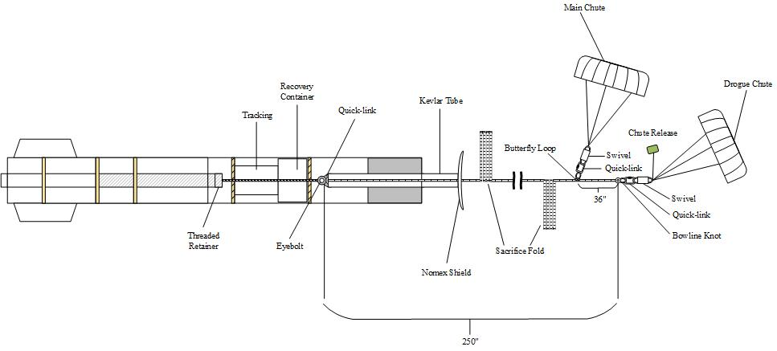
Aft Recovery Section
24

Slide 25
Kinetic Energy During Mission
Predicted kinetic energy on landing
Based on estimated land velocity
Section | Weight (lb.) | Main Size (ft.) | Drogue Size (ft.) | Main Velocity (ft./s) | Drogue Velocity (ft./s) | Landing Velocity (ft./s) | Drogue Kinetic Energy (ft.-lbf.) | Landing Kinetic Energy (ft.-lbf.)
Nosecone | 4.4 | 7 | 2 | 14.50 | 76.88 | 14.14 | 403 | 13.66
Payload | 15.0 |  |  |  |  |  | 1,376 | 46.57
Aft | 14.9 | 6 | 1.5 | 14.93 | 80.40 | 14.61 | 1,495 | 49.38
25

Slide 26
Predicted Drift
Predictions based on wind velocity * descent time
Simulation | Cross Wind Velocity (ft./s)
Section | Program | Descent Time (s) | 0 | 5 | 10 | 15 | 20
Fore | MATLAB | 115.7 | 0 | 579 | 1,157 | 1,735 | 2,314
 | OpenRocket | 100.2 | 0 | 501 | 1002 | 1503 | 2004
Aft | MATLAB | 111.5 | 0 | 558 | 1115 | 1672 | 2230
 | OpenRocket | 100 | 0 | 501 | 1002 | 1503 | 2004
26

Slide 27
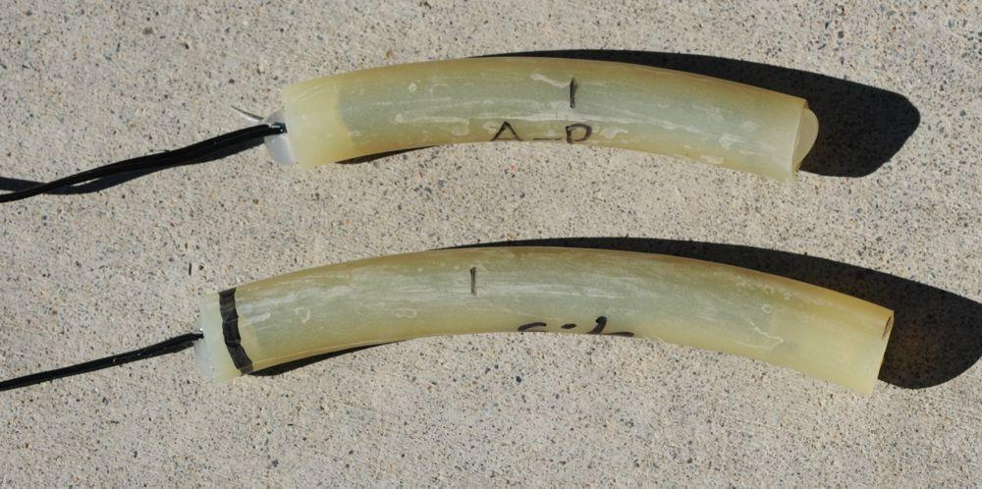
Ejection Charges
Estimated charge for sub-scale: 0.0367 oz.
Required five times estimated
Rerun calculation for full scale
Secondary charges 150% primary
Sub-Scale Test Results
Charge size (oz.) | Pass/Fail
0.052911 | fail
0.070548 | fail
0.088185 | fail
0.141096 | pass
27

Slide 28
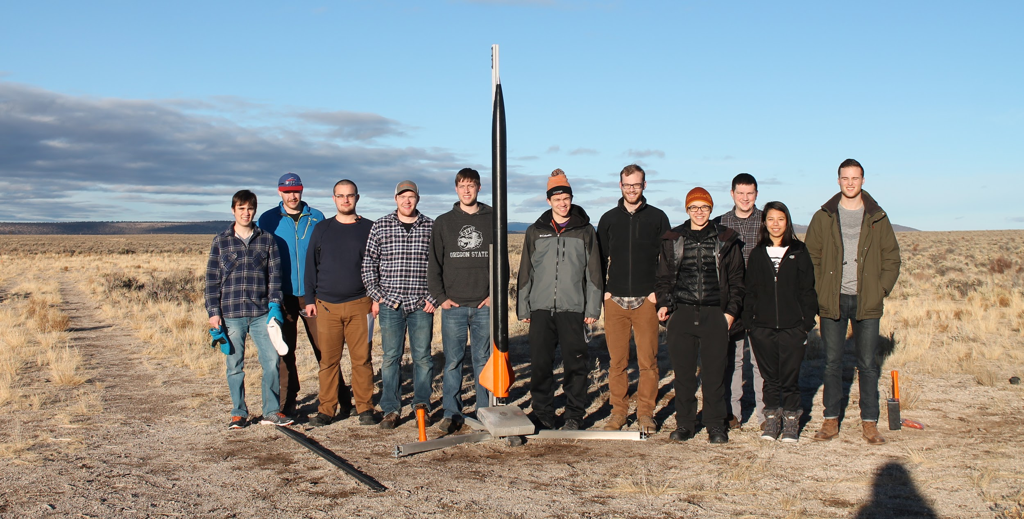
Subscale Launch
28

Slide 29
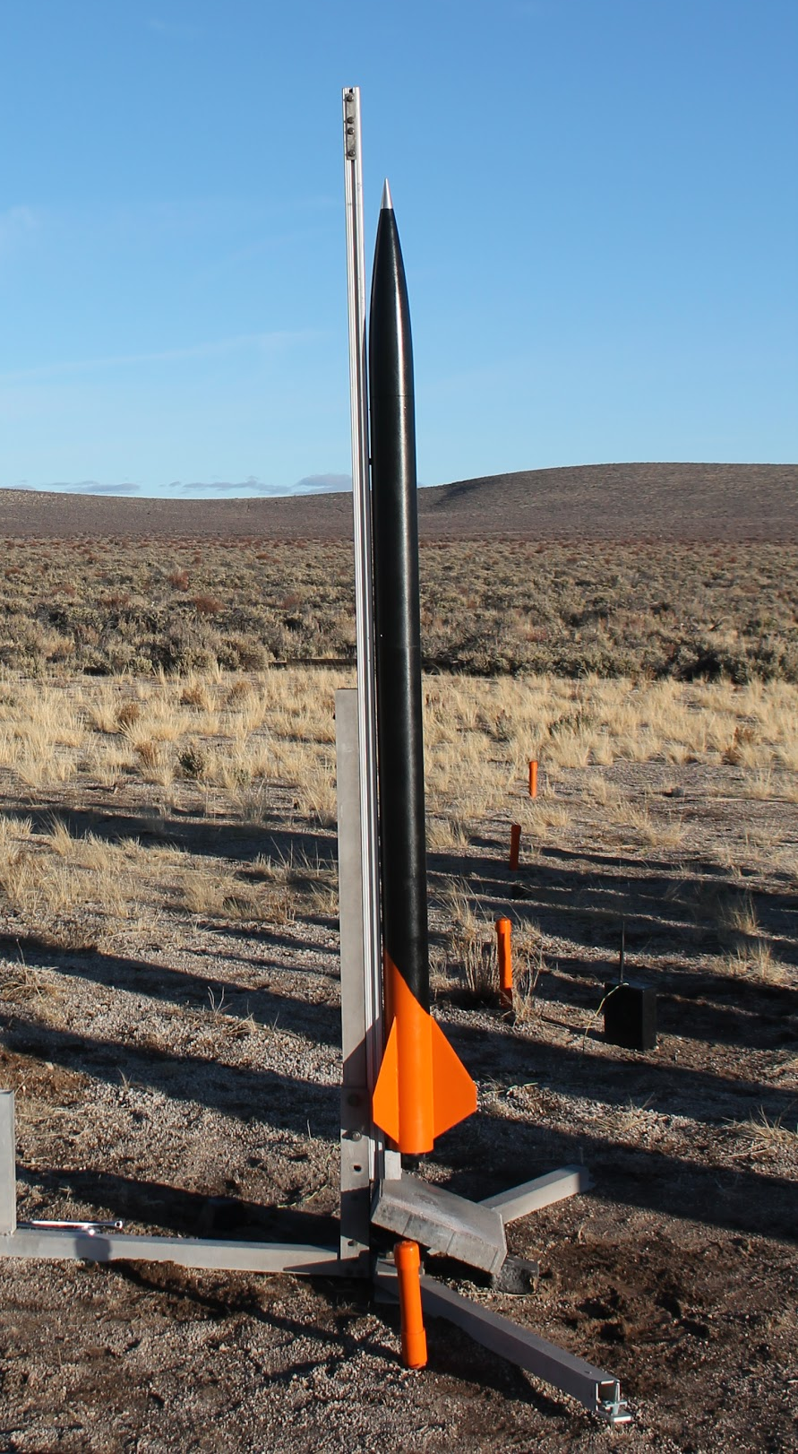
Sub-Scale Launch Vehicle
Sub-scale parameters:
4 in. Mad Dog DD rocket
⅘ size of full-scale rocket
16.5 lb. at launch - 44% of full-scale
K1103x motor
29

Slide 30
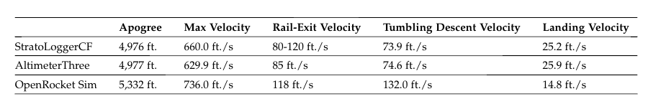
Sub-Scale Launch
Launch took place on January 6th, 2018 in Brothers, Oregon
Results:
30

Slide 31
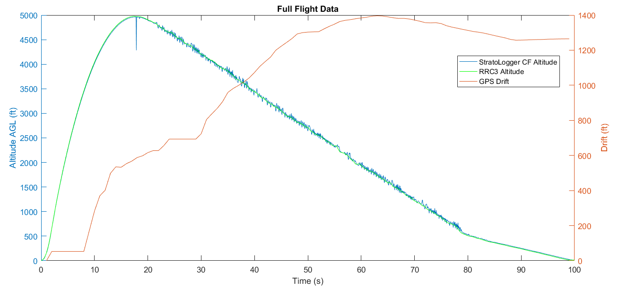
Sub-Scale Launch
Drift: 1265 ft.
Apogee: 4977 ft.
31

Slide 32
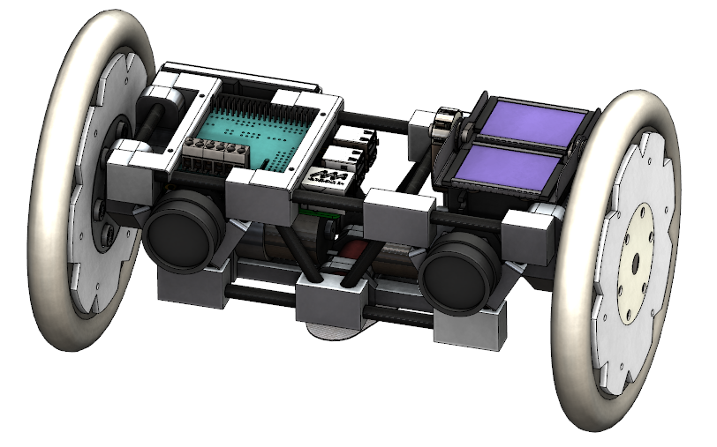
Payload Overview
Compressed Wheel Diameter: 4.8 in.
Expanded Wheel Diameter: 6.05 in.
Rover Length: 10.625 in.
Rover Mass: 4.53 lb.
Ejection Mass: 4.07 lbs.
32

Slide 33
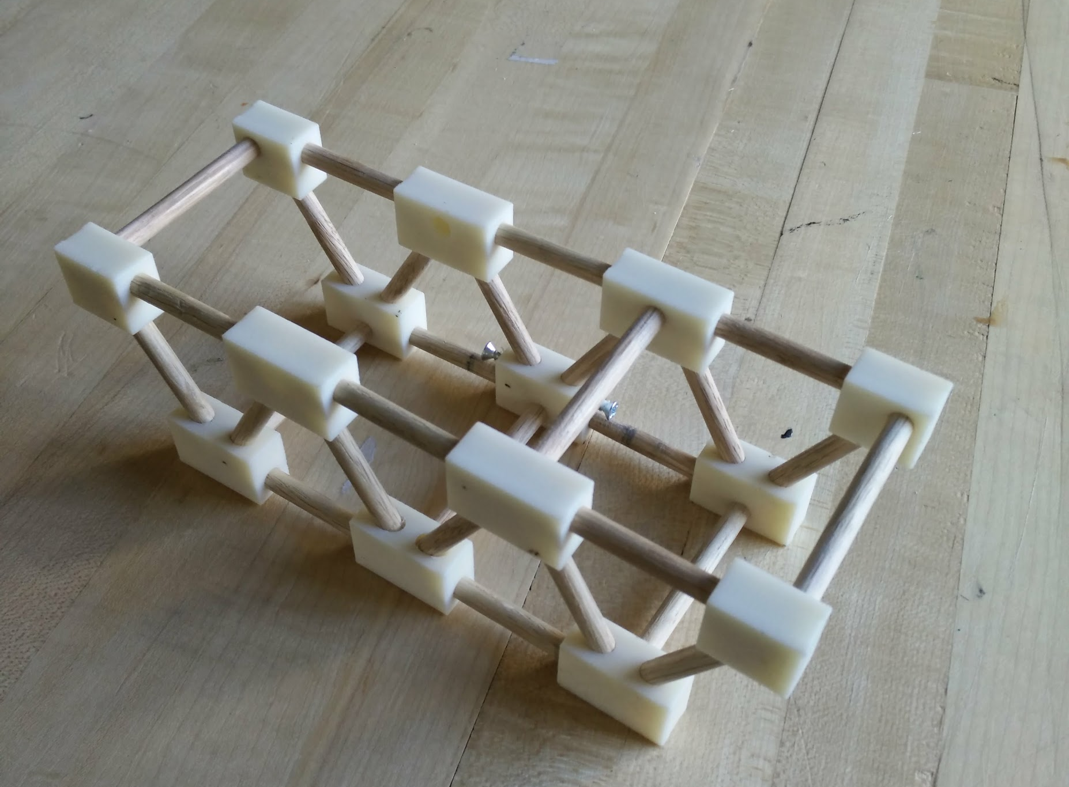
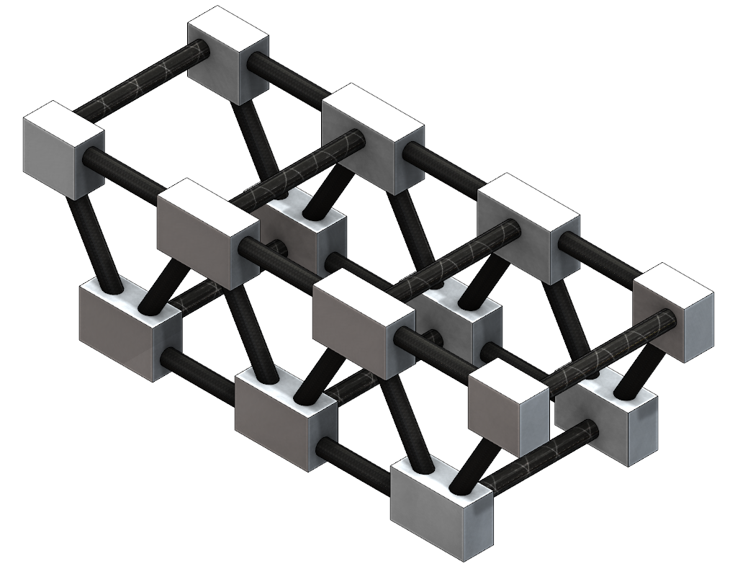
Payload: Rover Chassis
Aluminum and Carbon Fiber Truss
Oak and ABS Prototype
Final Design
33

Slide 34
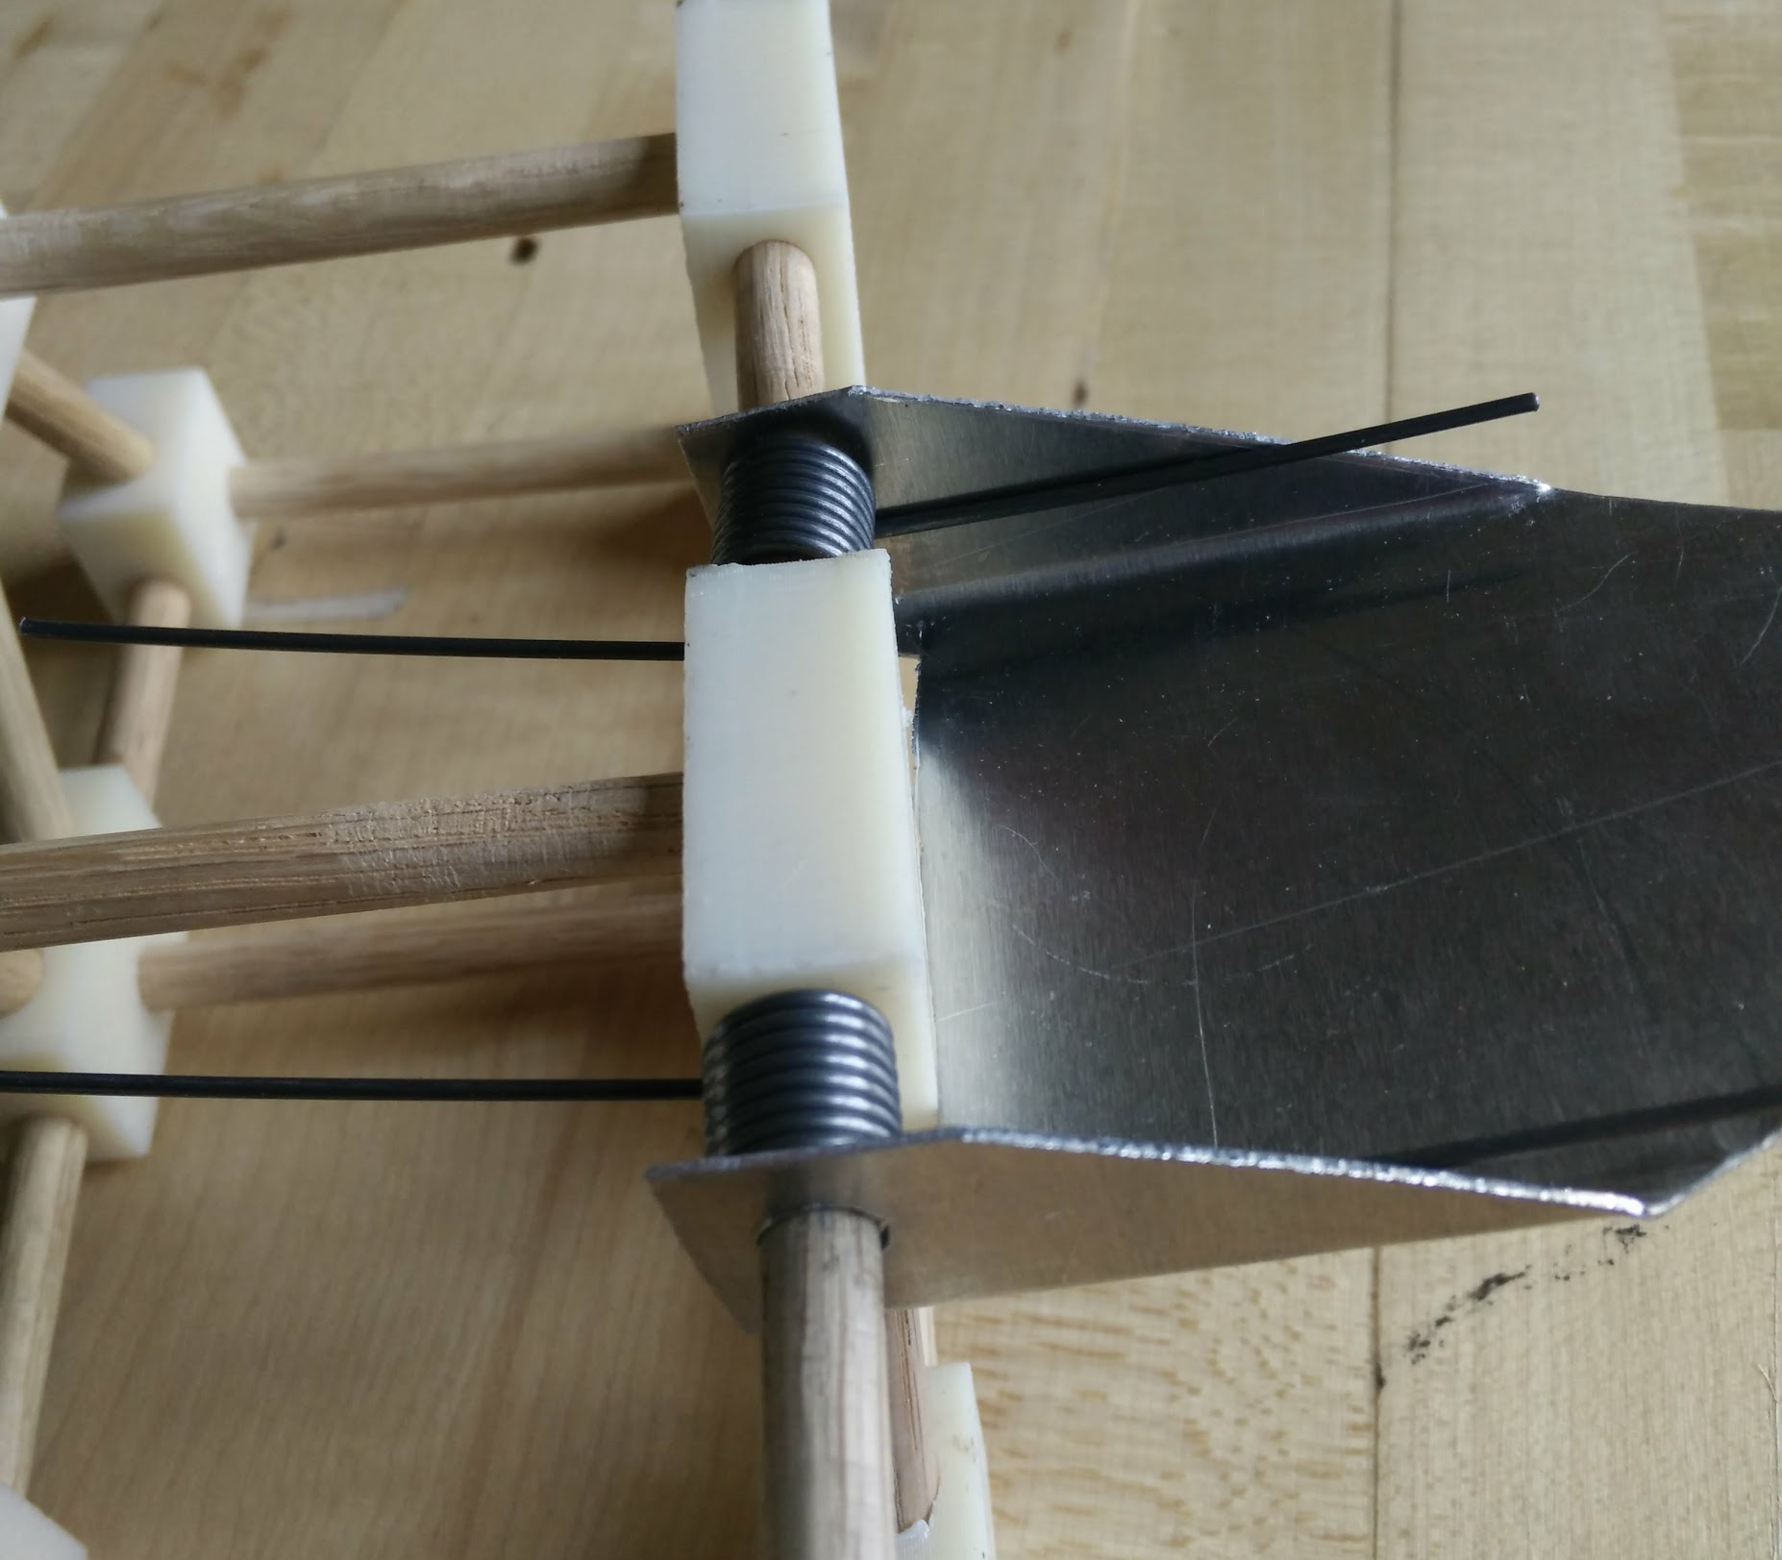
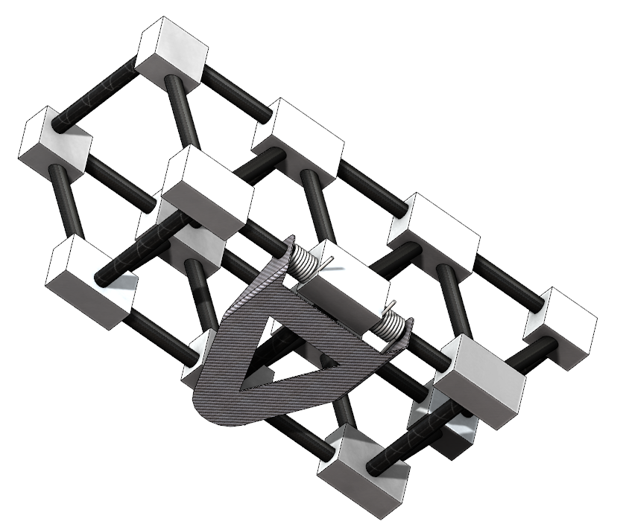
Payload: Rover Stabilizer
Spring-Loaded Carbon Fiber Stabilizer
Sheet Metal Prototype
Final Design
34

Slide 35
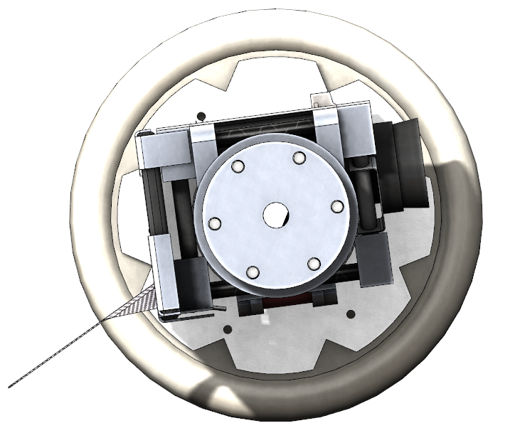
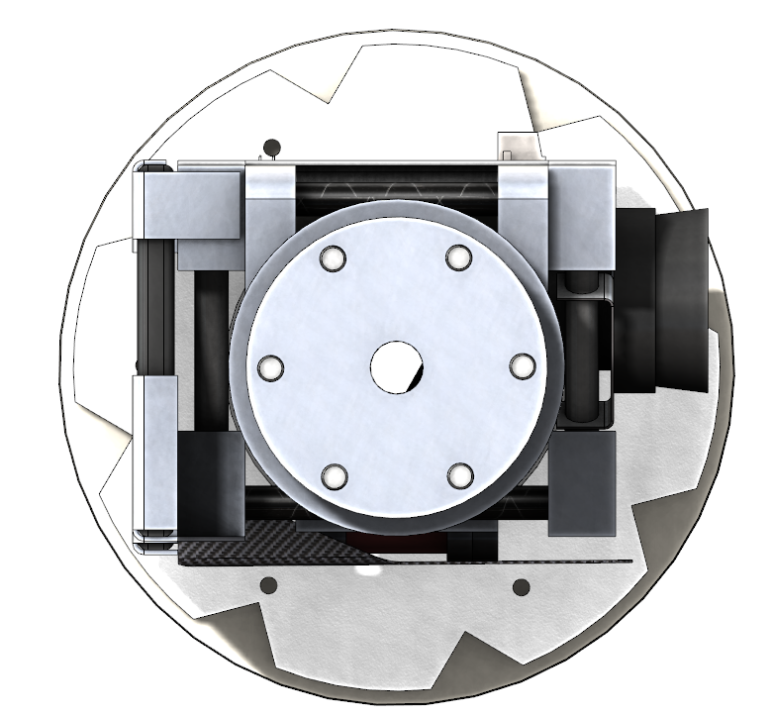
Payload: Deployment
Compressed to 4.8 in.
Stabilizer folded
Expanded to 6.05 in.
Stabilizer extended
35

Slide 36
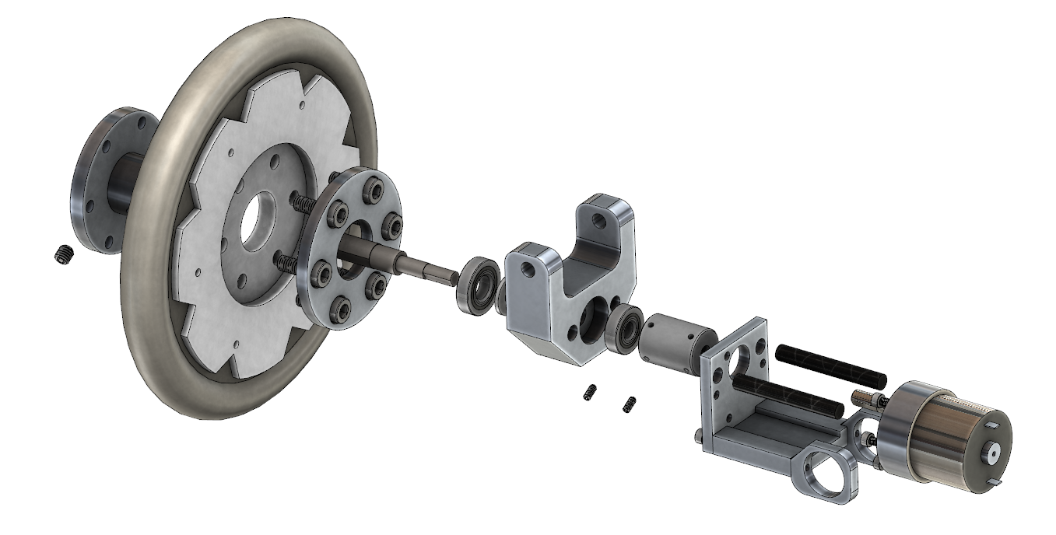
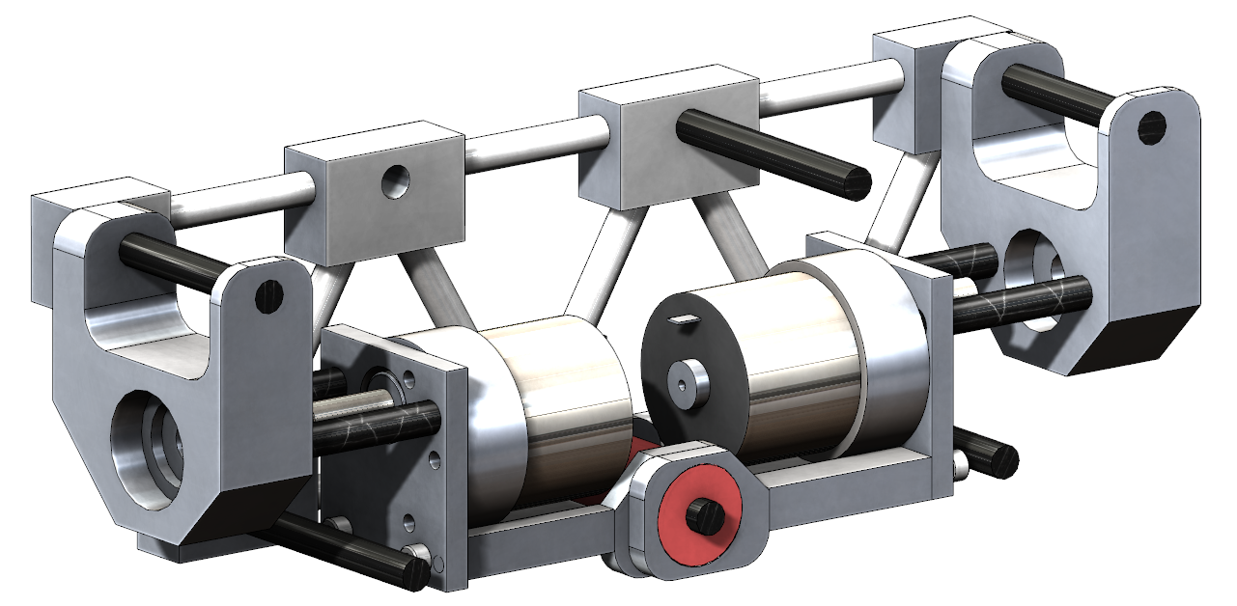
Payload: Rover Drivetrain
Compressed Wheel Diameter: 4.8 in.
Expanded Wheel Diameter: 6.05 in.
Max Motor Torque: 7.81 lb.-in.
Max rpm: 146 rpm
36

Slide 37
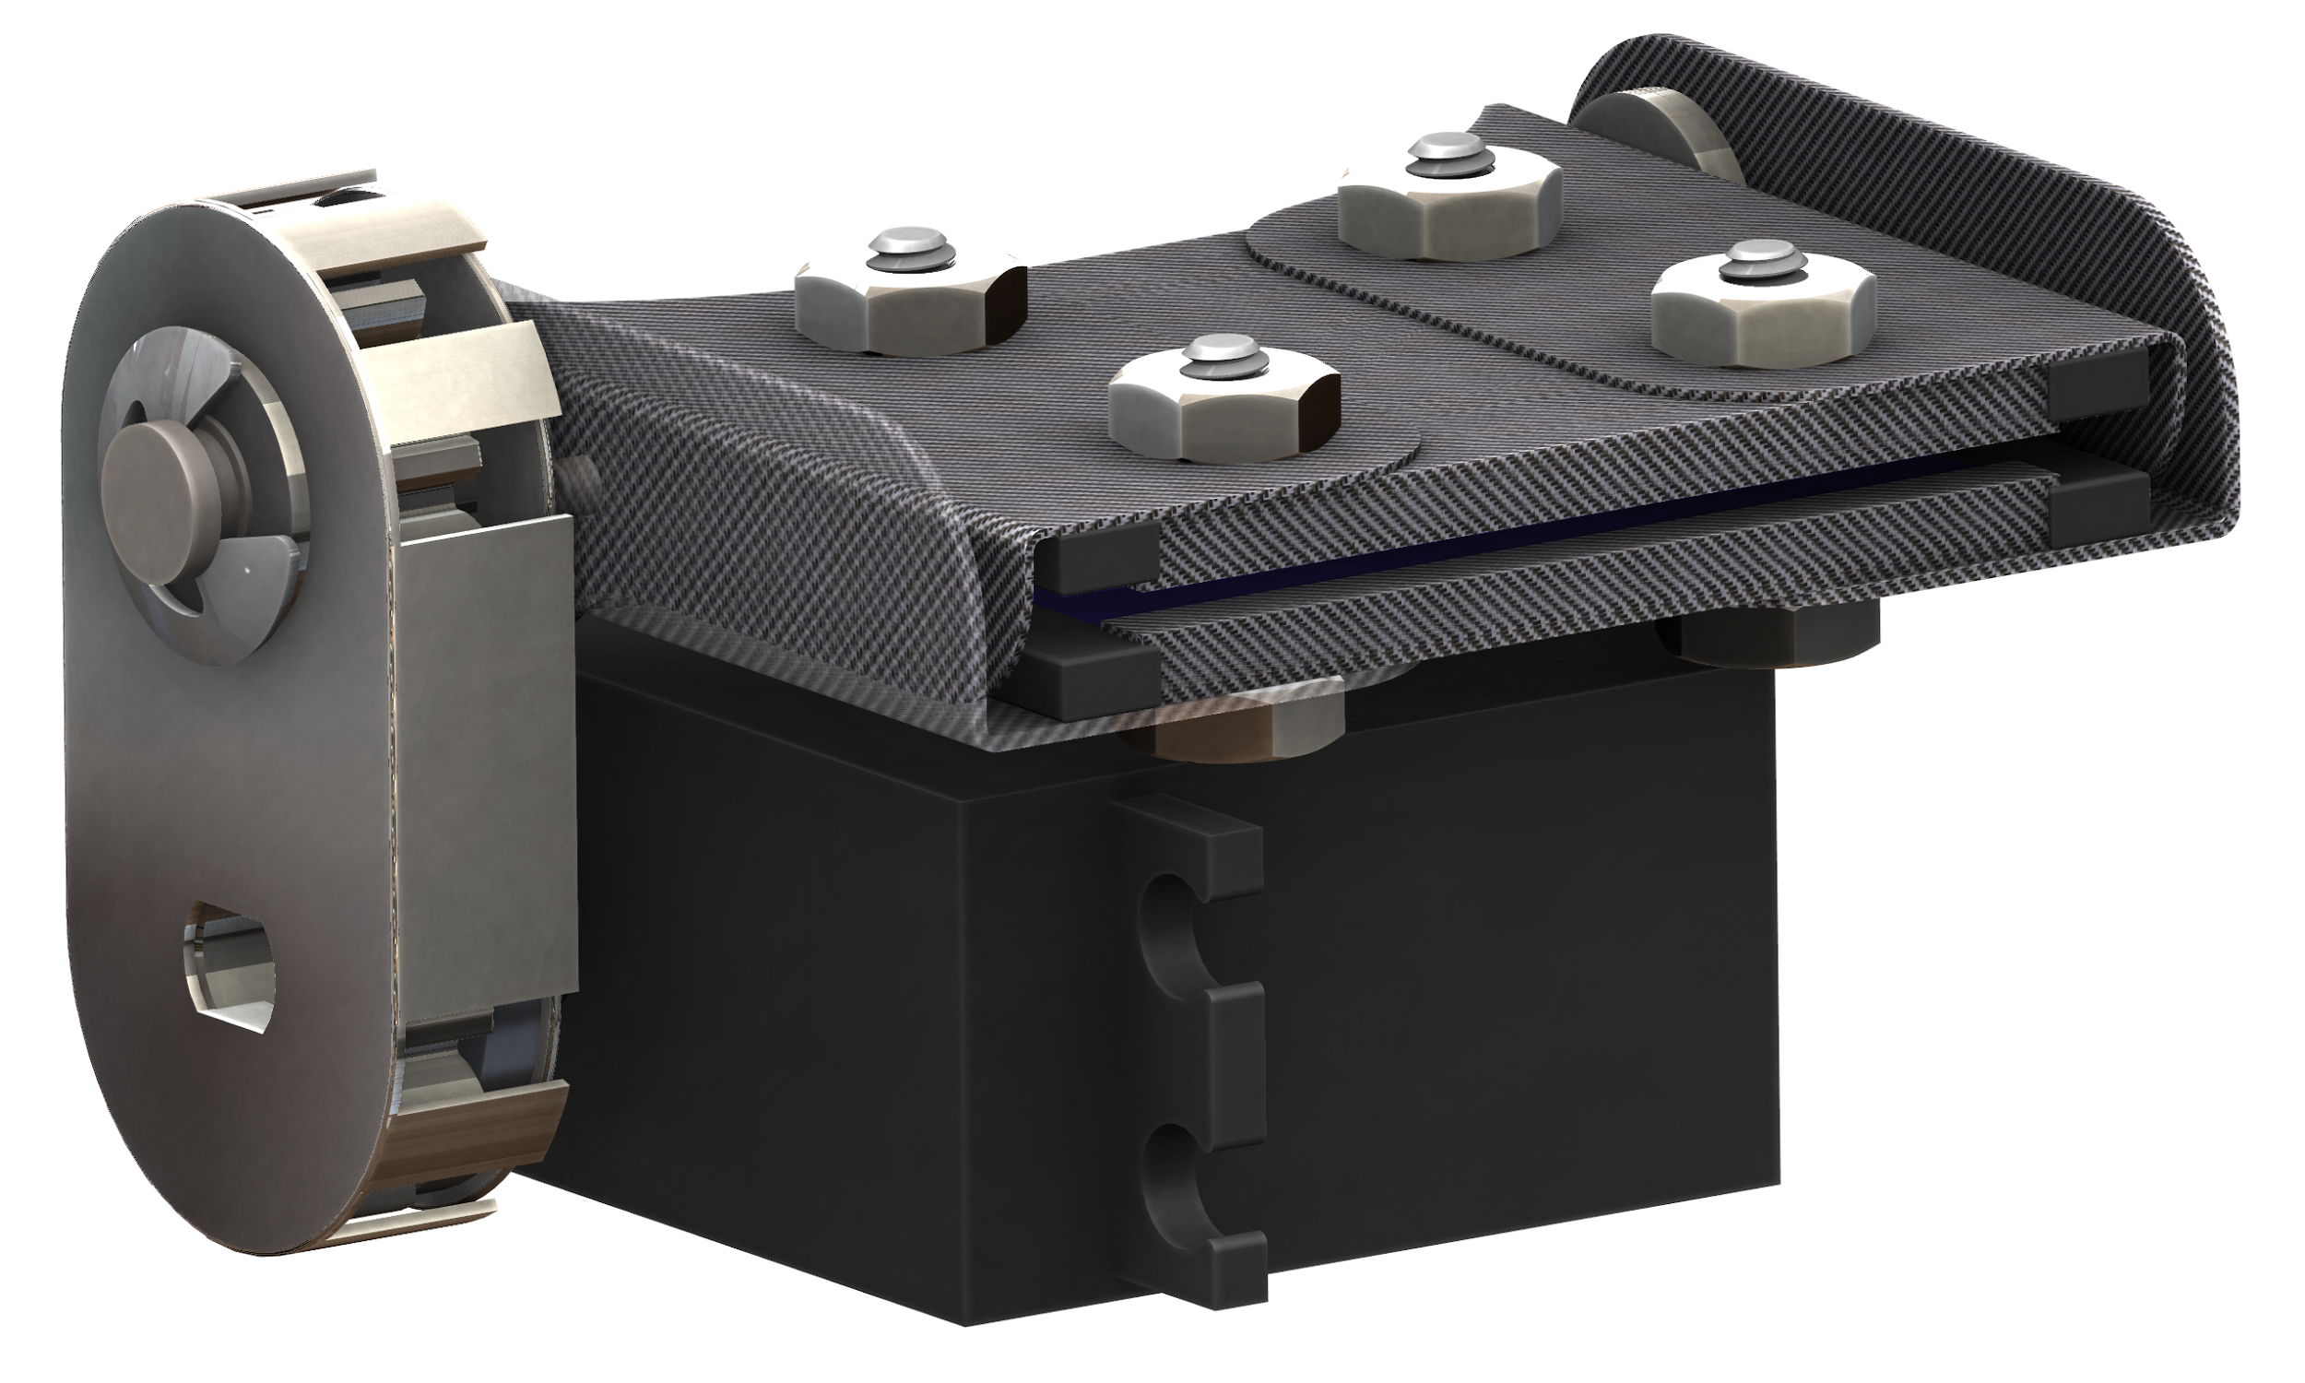
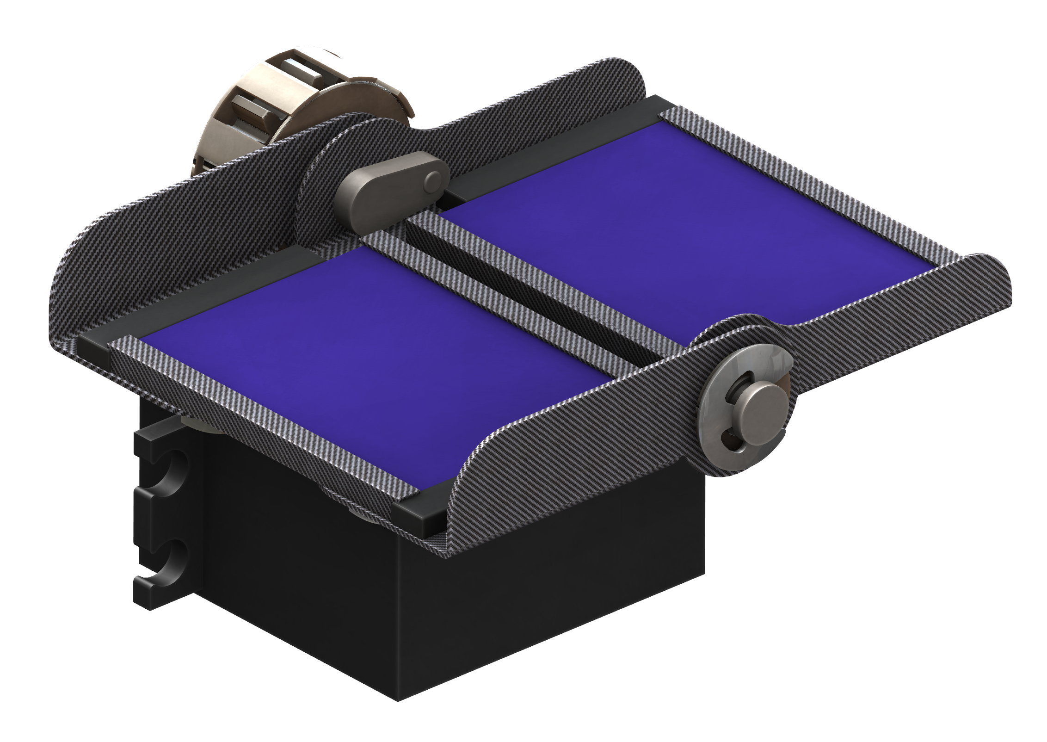
Payload: Rover Solar
Fully enclosed panels
Carbon fiber shield
Foam padding
Enclosed gears
180 deg. expansion
188.9 oz.-in. servo
8.0 lb. end-panel actuation
37

Slide 38
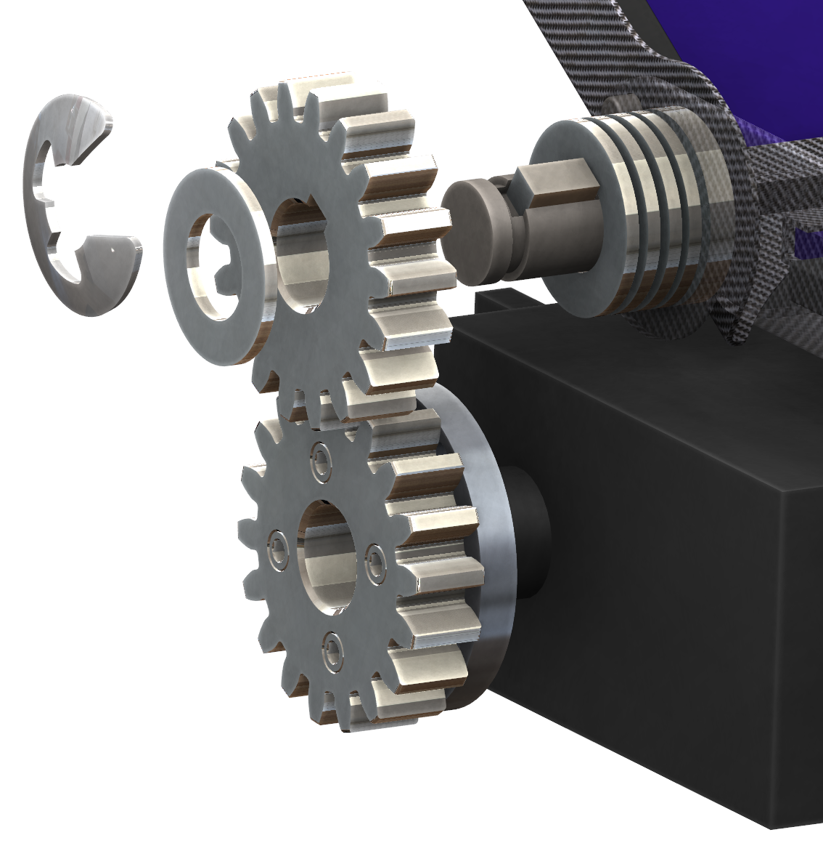
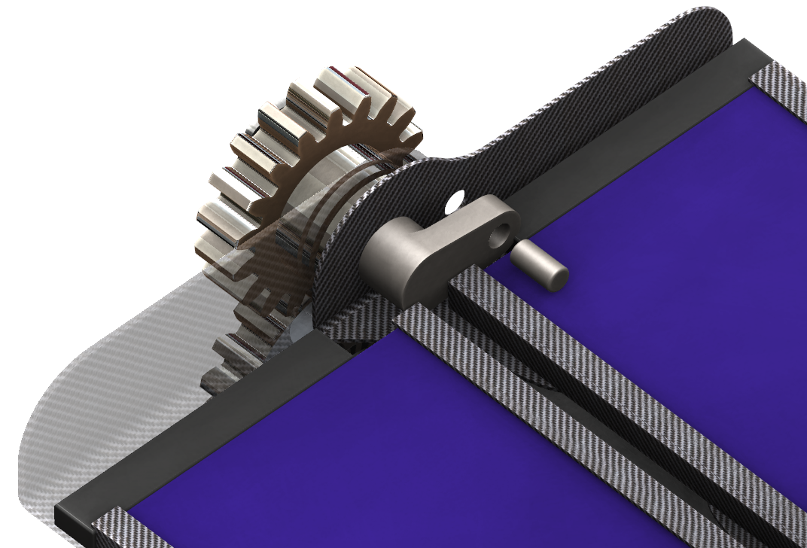
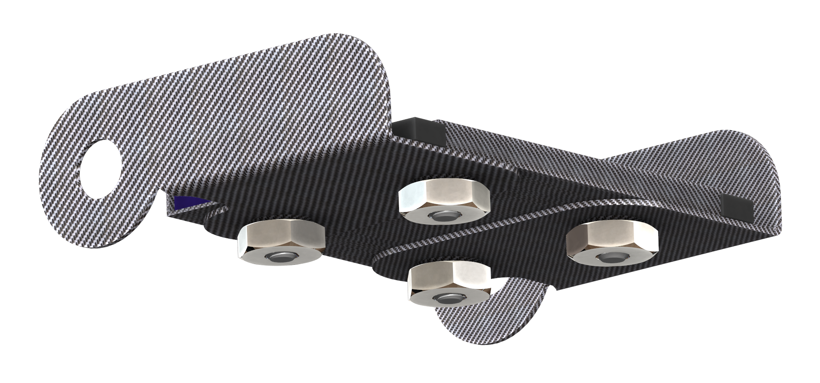
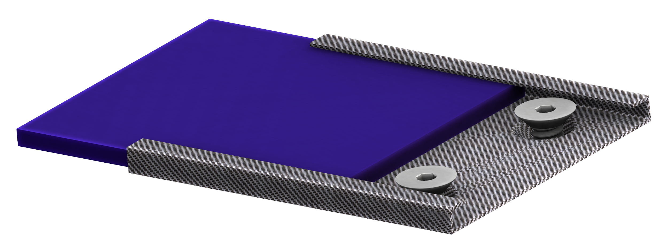
Payload: Rover Solar
Steel Gears
Spring Retaining Clips
Keyed Shaft
Sliding Panel
Threaded Fasteners
38

Slide 39
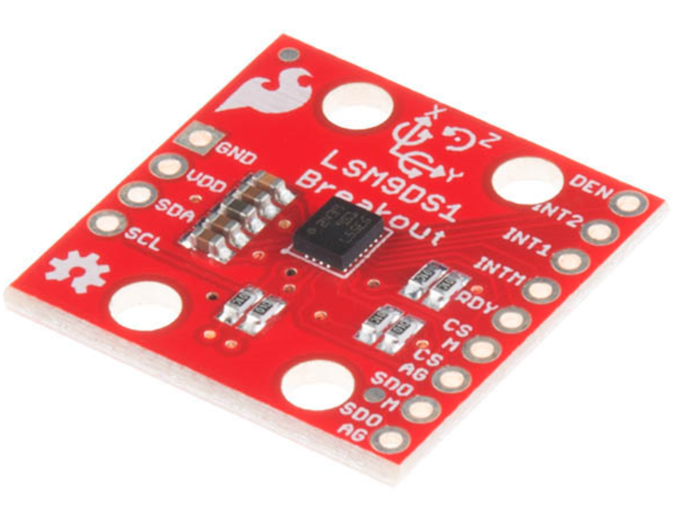
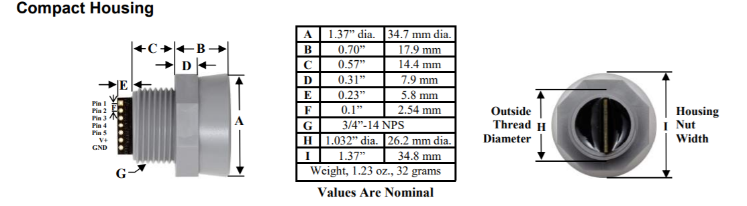
Payload: Rover Electronics
Object Detection Sensors (Sonar)
Inertial Localization (IMU)
Light Detection Sensor
39

Slide 40
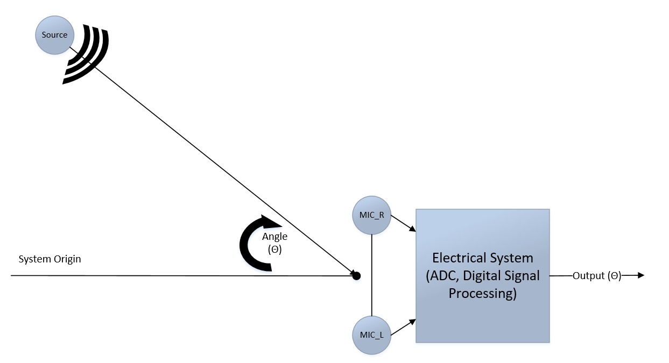
Payload: Rover Electronics
Waypoint Localization System
40

Slide 41
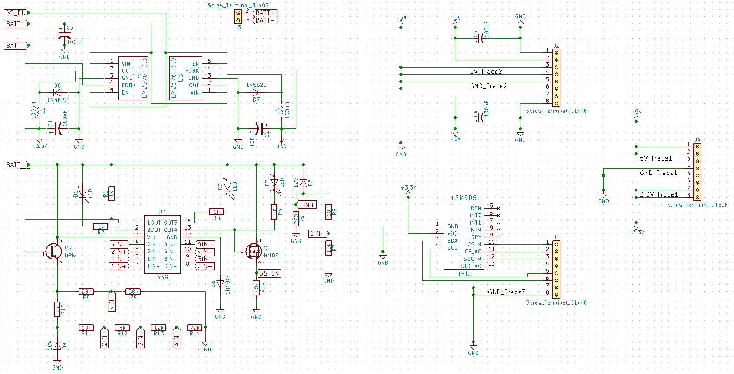
Payload: Rover Electronics
41

Slide 42

Payload: Rover Software
ROS on the Raspberry Pi - algorithm hierarchy
Simultaneous location and mapping
Sensor-based object avoidance
Basic movement
42

Slide 43


Payload: Retention Mechanism
PRIMARY
SECONDARY
Secondary: 300 lb. kevlar cord
Figure-eight follow through knot
43

Slide 44


Payload: Ejection Mechanism
Carbon fiber wrap, Kevlar straps, Plywood bulkheads
Black powder charges: 6 g
Mechanisms: 3.63 lb.
Controllers: 0.44 lb.
44

Slide 45

Payload: Ejection Controller
45

Slide 46

Test Plans
Major testing procedures include:
Separation Ejection Testing
Launch Vehicle Assembly Testing
Payload Ejection Testing
Payload Performance Testing:
Hill Climb
Maximum Velocity
Obstacle Detection
Solar Deployment
46

Slide 47
Test Plans: Separation Ejection
Passing Conditions:
Success: separation of sections and parachute ejection from packing; tether fully extended
Types of Failures: Strength, Ejection, and Partial Separation
Test Materials Required:
Black powder
Pressure sensor
Ejection interface
Test Procedure:
Attach charges to bulkhead
Attach pressure sensor
Close body tubes/insert shear pins
Perform safety protocols
Initiate test
Record results test
Record pressure data
Repeat as necessary
47

Slide 48

Test Plans: Separation Ejection
Status - Incomplete
Failed for subscale - only one test complete
Scheduled to be done during January and February 2018 testing
48

Slide 49
Test Plans: Launch Vehicle Assembly
Passing Conditions:
Total weight < 45 lbs.
Time required < 2.5 hrs.
Internal volume > 4500 in.³
Component number < 40
Test Materials Required:
Precise scale
Timer
Measuring tape
Test Procedures:
Measure interior space
Start timer
Assemble the launch vehicle
Stop timer
Place vehicle on scale
Count components
49

Slide 50

Test Plans: Launch Vehicle Assembly
Status - Incomplete
Scheduled to be done during January and February 2018 testing
50

Slide 51
Test Plans: Payload Ejection
Passing Conditions:
Rover clears airframe
Avoid entanglement
Successful 5 ft. travel
Test Materials Required:
Test apparatus
Payload ejection housing
Rover payload
E-matches
Black powder
Test Procedures:
Secure airframe
Place black powder charge
Insert dummy payload
Secure the payload housing
Activate charges
Retrieve rover
51

Slide 52

Test Plans: Payload Ejection
Status - Incomplete
Scheduled to be tested in January
52

Slide 53
Test Plans: Payload Performance
Hill Climb:
Success: Target hillclimb of 30º hill for fully assembled rover
Maximum Velocity:
Success: Target velocity of 5 ft./s on a tiled, level field
Object Detection:
Success: Ensure 90% pass rate for static assembly
Solar Deployment:
Success: Ratio of successful tests is above 90%
53

Slide 54

Test Plans: Payload Performance
Status - Incomplete
Scheduled to be done during January and February 2018 testing
54

Slide 55

Requirement Verification
55

Slide 56

Educational Outreach
Four Outreach Events Completed
Silver Crest Middle School - 19 students
Model Rocket Launch
Philomath Middle School - 21 students
Model Rocket Launch
Sprague High School - 191 students
Aerodynamics, Matchstick Rockets, & Electromagnetism
Walker Middle School - 191 students
Electromagnetism & Mousetrap Cars
422 students reached!
56

Slide 57

Educational Outreach
Future Events
West Salem High School
Corvallis High School
Future Planning
Connections with STEM district managers for events next year i.e. Science fairs, events, and guest presentations
Writing up all lesson plans generated during group “think tanks”
57

Slide 58

Questions?
55

